Slide 1
COVID-19 Protection Framework
The COVID-19 Protection Framework lays out our domestic response measures for a highly vaccinated population
It supports the next steps of New Zealand's reconnection with the world.​
22 Oct 2021 v1
Notes:
One of the tools that has helped NZ succeed has been our Alert Level system. This has guided us all through the first phase of pandemic, has served us well, protected us and kept thousands from getting sick or, worse, dying from COVID-19. It’s something we’re incredibly proud of.
The Elimination Strategy has worked well for New Zealand but it is not feasible for it to continue long term and it is extremely difficult to maintain with the Delta variant.
Delta has changed how we manage COVID-19, it’s also led to more uncertainty. In the past few weeks, it’s become clear that we need a new system to support us to move to a new chapter, where we learn to live with COVID-19 in a managed way, minimising the impacts it has on our day-to-day lives.
The new framework reflects our kiwi ethos of doing the right thing for your community while living a life with the minimum limitations necessary. Vaccination and health system readiness are the critical enablers of the new framework.
The new COVID-19 Protection Framework will provide clarity, enable more activity and help us all to plan ahead. It is developed from the existing Alert Level system which has worked well, but also recognises how high levels of vaccination open up more possibilities.

Slide 2
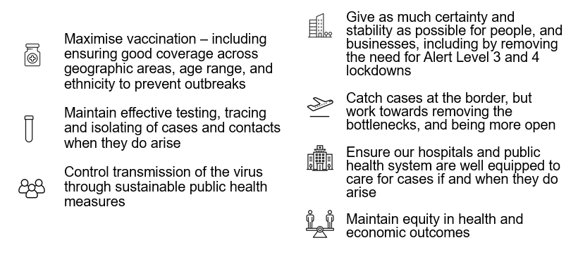
Minimise and Protect
Minimisation means that we are aiming to keep the spread of COVID-19 at as low a level as possible.
It means containing and controlling any outbreaks, and if practical to do so, stamping it out.
Notes:
Shifting the focus of the response from elimination to an approach based on minimisation and protection. We need to keep our economy moving, look after people’s wellbeing and get on with our plan to reconnect New Zealand to the world.
Minimisation means we are aiming to keep the spread of COVID-19 at as low a level as possible. More than likely some level of cases in the community on an ongoing basis, and means containing and controlling outbreaks.
The new approach has 7 goals (listed on the slide).

Slide 3
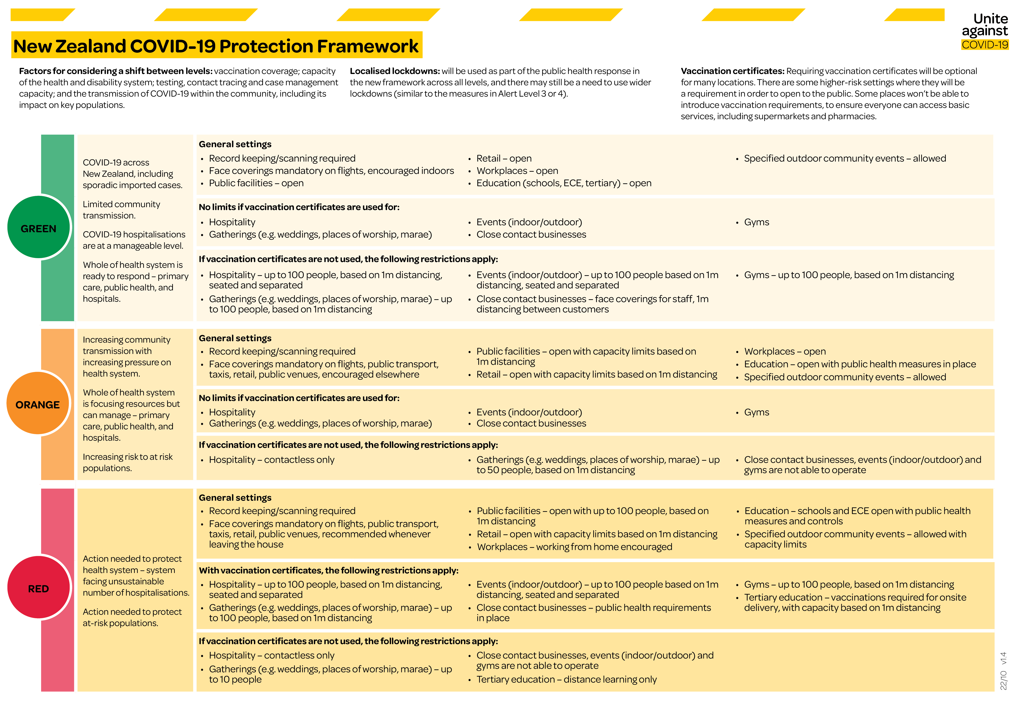
Notes:
The COVID-19 Protection Framework has:
Green aims to allow almost normal social and economic activity while continuing to build health system capacity
Orange aims to avoid exponential growth in cases with moderate population level controls, and
Red aims to protect the sustainability of the health system and the health of communities through population-level controls.
COVID-19 Public Health Response Act 2020 retains the power to put in place wider lockdowns, as for Alert level 3 and 4, if pressure on the health system becomes unmanageable, or if there are new variants that evade our protection from immunity.

Slide 4
Trigger for the transition
Vaccination coverage across the overall population and equity of vaccination coverage
Auckland to move into the new framework when 90 percent of eligible population in each of the three DHBs are fully vaccinated.
90 percent fully vaccinated target set across each DHB region before rest of the country moves into new system.
Once the South Island reaches a 90% vaccination rate in all areas there is the potential to transition to the new system.
Each option will be considered closer to the time.
Other supporting tools
The capacity of the health and disability system to manage COVID-19 cases (including across public health, primary health care, community services and secondary care).
Testing, contact tracing and case management capacity.
The transmission of COVID-19 within the community, including its impact on key populations.
Notes:
When we hit the milestone of 90% vaccination rates in each region, we will be ready to implement the new framework.
We acknowledge that some communities are more at risk than others. We are taking the strongest steps we can to protect those most vulnerable parts as we make this move. The key way we can do that is by getting consistently high levels of vaccination across all communities and this is our current focus.
We won’t move until it is sufficiently safe to do so, and until we are ready. Until then we will stick with the current Alert Levels and continue to do the preparation work so we are ready to implement the next stage of the plan.
We need to work hard to ensure that intensive efforts continue to life vaccination rates for Maori and vulnerable groups before and after transition.

Slide 5
Next steps
Late-October: Further details provided on the implementation of COVID-19 Vaccination certificates, including any primary legislation to enable CVCs to be used as anticipated.
Mid-November: Further details developed on progress for the transition plan for Auckland and the rest of NZ.
Throughout November:
Further advice developed on new testing, tracing and isolation strategies.
Further advice developed on potential new approach to economic supports.
Further work on a revised approach to welfare and community-based supports, including food and other essential wellbeing provisions.
Ongoing: Work continues in operational readiness for a switch to the new approach and its new implementation.

